Slide 1
Navigating the Obstacle Course Tools
Michelle Goldsmith
SOM – May 4, 2019

Slide 2
Course Objectives
The student will be able to answer questions regarding the following:
  How to register a course
  How to edit a course
  Student registration
  Closing of a course
  The proper “paper trail”

Slide 3
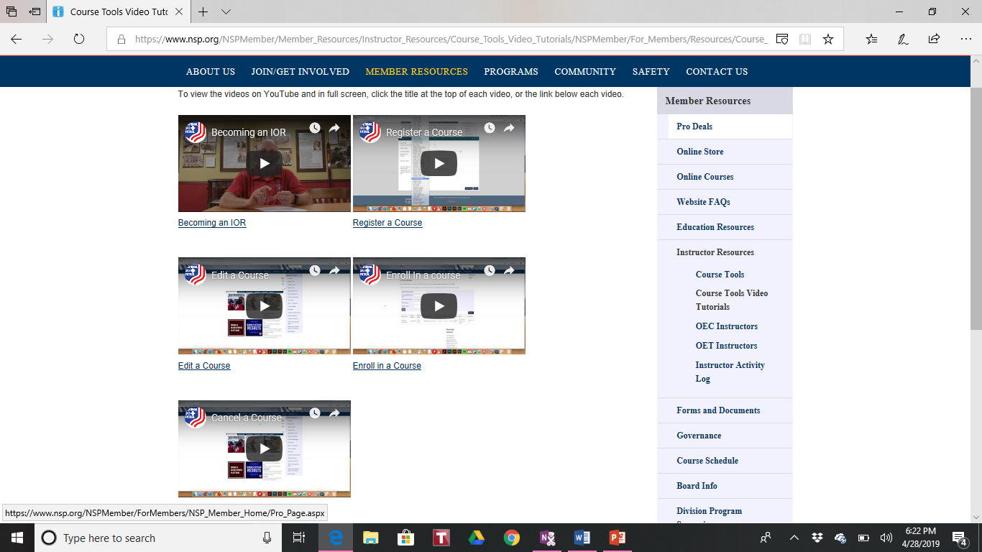
Course Tools Video Tutorials

Slide 4
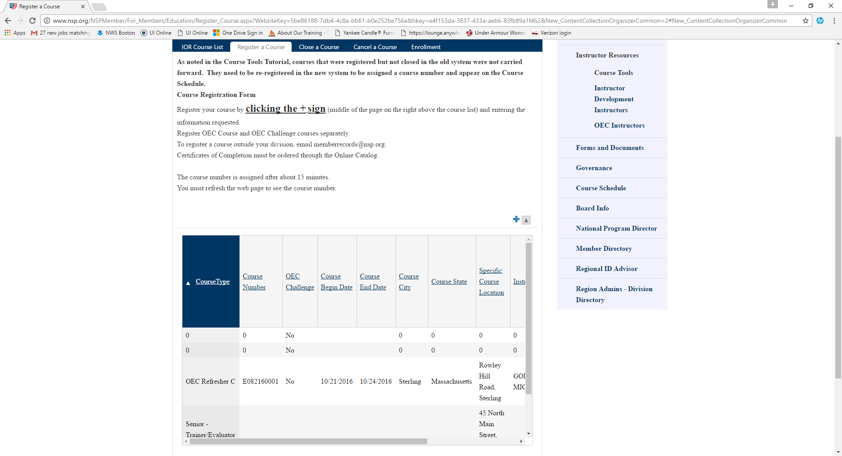
Register a Course

Slide 5
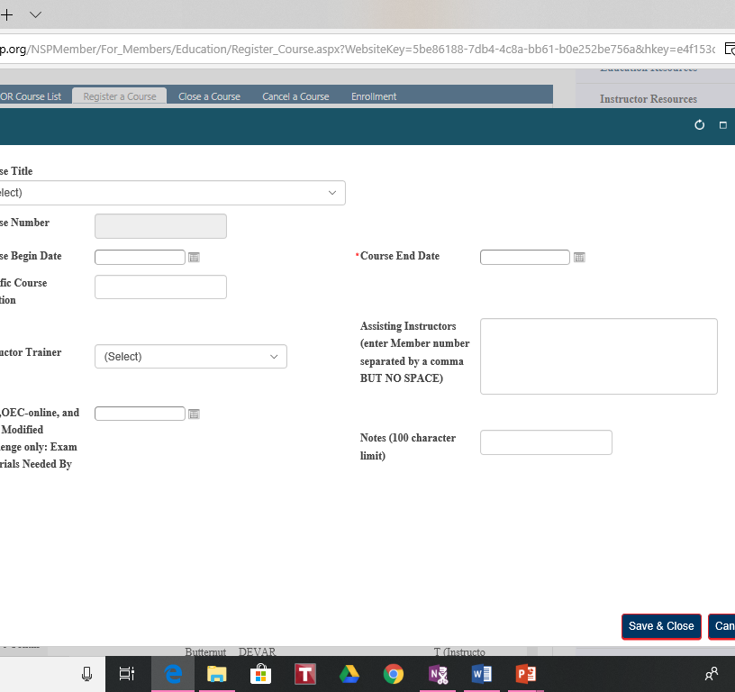
Setting the course information
If you are registering an OEC, OEC on-line or OEC modified challenge.
End date – buffer zone
Assisting instructors. WARNING! Cannot be a student in the course
Notes: “by invitation only”, “closed course”, “please contact…”

Slide 6
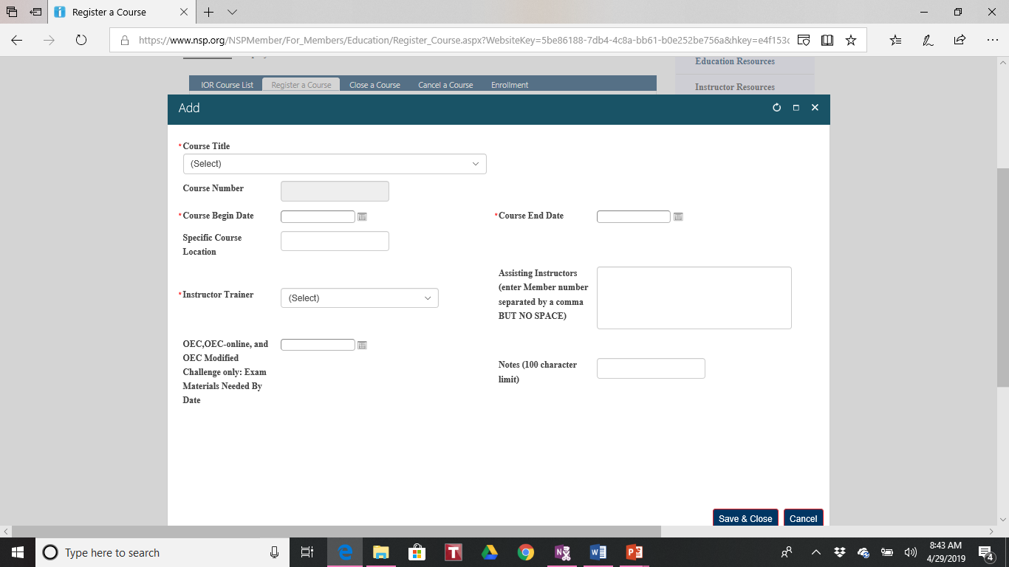
Volley vs Pro

Slide 7
If you are registering a course and you cannot see the particular IT (Instructor Trainer) you want to select:
Select another IT from within your region and send an email to National asking them to change the IT selected to the IT you will have in attendance.

Slide 8
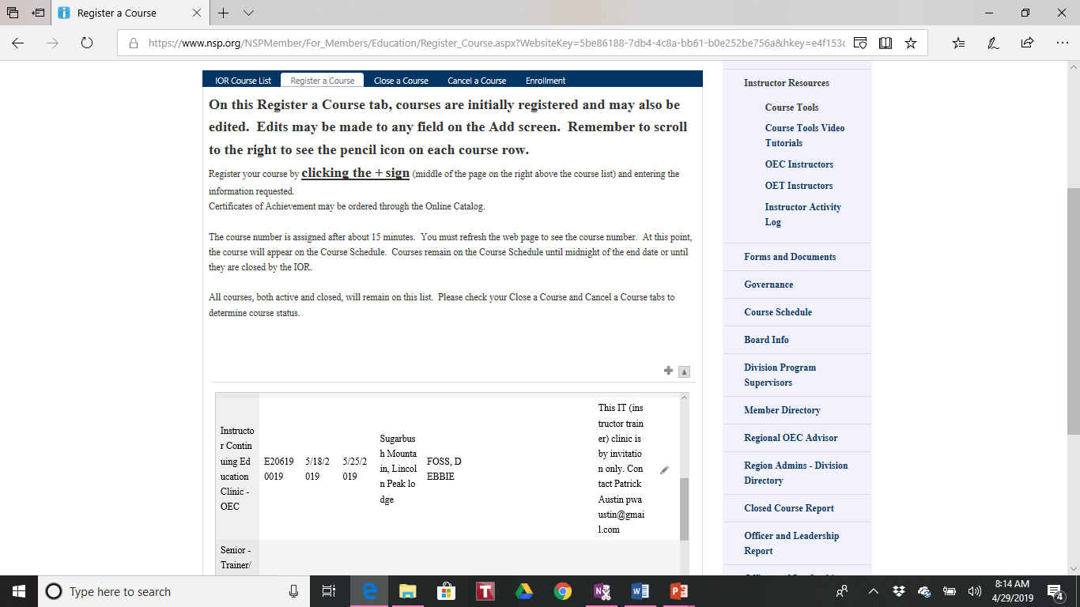
When you need to edit a course…

Slide 9
Who do I contact next…
If you are running a class that will be open to anyone interested you should contact the Regional webmaster and the Division webmaster to have it added to the calendar.
If this course is “by invitation only” or a “closed course” you should send the course number and instructions to the group of individuals you need to register.

Slide 10
Registering for a course:
Attendees MUST register for a course prior to attending.
An IOR will not receive credit as a student
Registrants need to register as a student OR an instructor but can not register as both
When enrolling in a course be sure to hit the “submit” button at the bottom of the screen

Slide 11
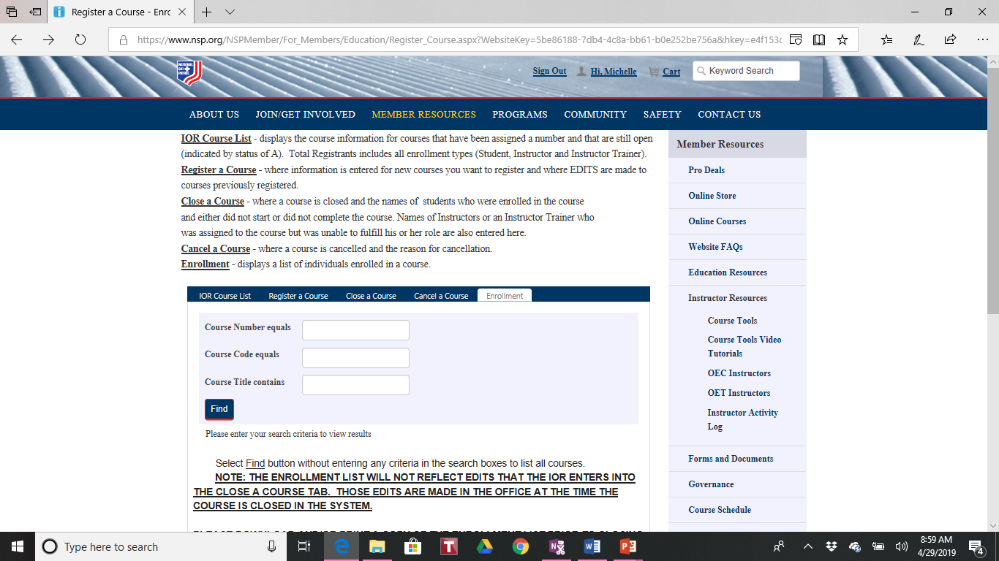
Before you close a course

Slide 12
Print and/or save a roster of all registrants for your class before you close it
Be sure all attendees are showing on the roster
Double check that those registered as instructors are not registered as students as well

Slide 13
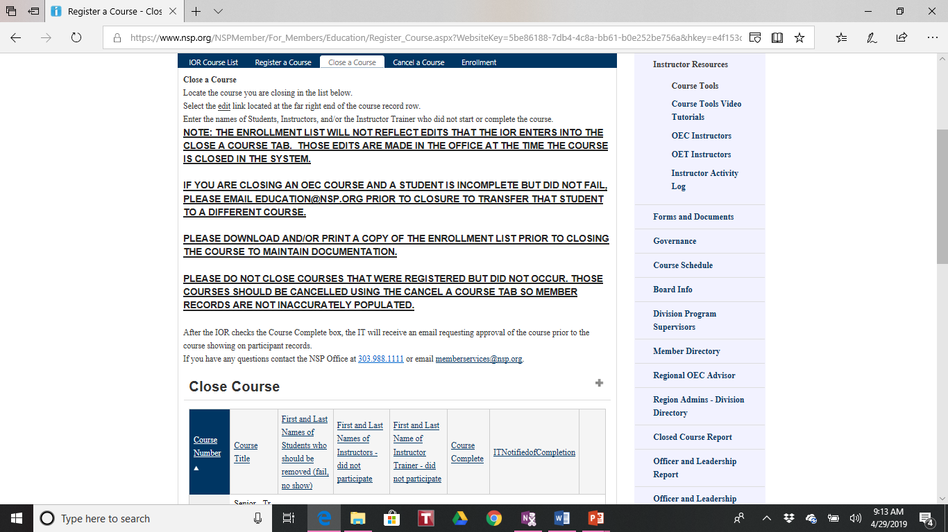
You are ready to close your course!

Slide 14
THE ENROLLMENT LIST WILL NOT REFLECT EDITS THAT THE IOR ENTERS INTO THE CLOSE A COURSE TAB. THOSE EDITS ARE MADE IN THE OFFICE AT THE TIME THE COURSE IS CLOSED IN THE SYSTEM.
IF YOU ARE CLOSING AN OEC COURSE AND A STUDENT IS INCOMPLETE BUT DID NOT FAIL, PLEASE EMAIL EDUCATION@NSP.ORG PRIOR TO CLOSURE TO TRANSFER THAT STUDENT TO A DIFFERENT COURSE.
PLEASE DOWNLOAD AND/OR PRINT A COPY OF THE ENROLLMENT LIST PRIOR TO CLOSING THE COURSE TO MAINTAIN DOCUMENTATION.
PLEASE DO NOT CLOSE COURSES THAT WERE REGISTERED BUT DID NOT OCCUR. THOSE COURSES SHOULD BE CANCELLED USING THE CANCEL A COURSE TAB SO MEMBER RECORDS ARE NOT INACCURATELY POPULATED.

Slide 15
But wait…
Be sure that all visiting patrollers were registered
Sign the appropriate paperwork for them to return to their PD.
Close your course in a timely manner to be sure patrollers receive credit for attending

Slide 16
Don’t go yet!!!
Send an email to the IT with the following information:
The roster of those in attendance.
Any notes that you sent when closing the course
Note those that were successful and those that were not successful

Slide 17
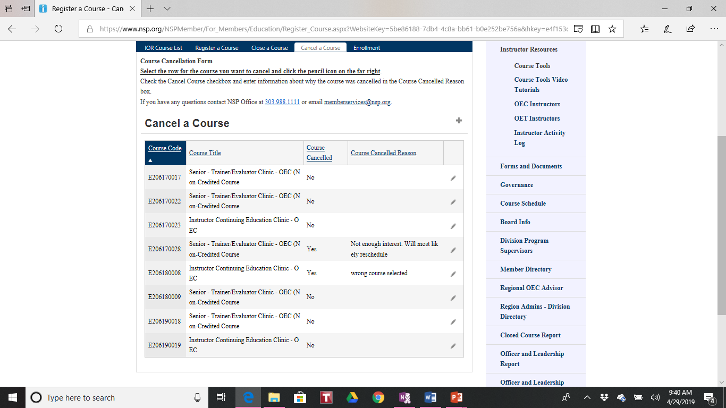
Oops…

Slide 18
Be sure to add your reason for cancelling a course

Slide 19
Last but not least!
The IT will receive an email from National requesting approval to close a course. This is an important final step in the process
All IT’s should send the QA evaluation to:
IOR
ROA
OEC Assistant supervisor
National

Slide 20
In Summary:
When registering a course be sure to fill in all the appropriate information and add notes if needed
When people are enrolling in your course instructors, and the IOR will not get credit as students
Save and/or print a copy of the roster prior to closing a course. Send a copy to the IT along with any notes your sent to National upon closing
IT’s are to approve the course closure when receiving the email from National

Slide 21
QUESTIONS???

